Slide 1
Median-finding Algorithm

Slide 2
Median of Medians

Slide 3

Median-finding Algorithm
Median-finding algorithms use a divide and conquer strategy to efficiently compute the $i^{th}$ smallest number in an unsorted list of size $n^{ }$ ($i$ is an integer between $1$ and $n$ )

Slide 4
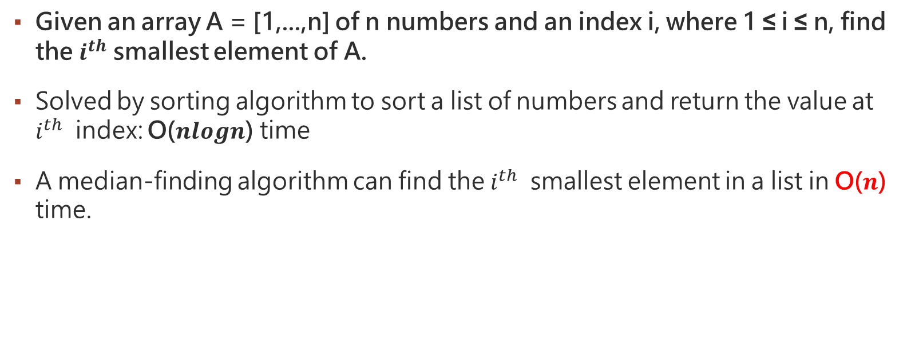
Problem
Given an array A = [1,...,n] of n numbers and an index i, where 1 ≤ i ≤ n, find the $i^{th}$ smallest element of A.
Solved by sorting algorithm to sort a list of numbers and return the value at $i^{th}$ index: O($nlogn$) time
A median-finding algorithm can find the $i^{th}$ smallest element in a list in O($n$) time.

Slide 5
Algorithm – Step 1
Divide the list into sublists each of length five (if there are fewer than five elements available for the last list, that is fine).
Eg: Divide A=[25,21,98,100,76,22,43,60,89,87] to
Sublist A1: A1=[25,21,98,100,76]
Sublist A2: A2=[22,43,60,89,87]

Slide 6
Algorithm – Step 2
Determine the median of every sublist.
Sorting very small lists takes linear time since these sublists have five elements, and this takes O(n) time.
If the list has an even number of elements, take the floor of the length of the list divided by 2 to find the index of the median.
Eg: Sort A1=[25,21,98,100,76] , A2=[22,43,60,89,87] to
A1=[21,25,76,98,100] , A2=[22,43,60,87,89]
Get the median out of each list and put them in a list of medians, M:
A1: 76 , A2: 60
M = [76, 60]

Slide 7
Algorithm – Step 3
Use the median-of-median algorithm to recursively determine the median of the set of all the medians.
Eg: M=[76,60]
Sort this: M = [60,76]
Pick the median from that list, the length of the list is 2, median index : 2/2=1
Median = M[1] = 76

Slide 8
Algorithm – Step 4
Use this median as the pivot element, x. The pivot is an approximate median of the whole list and then each recursive step hones in on the true median.
median
21 | 25 | 76 | 98 | 100
22 | 43 | 60 | 87 | 89
60
76
median

Slide 9
Algorithm – Step 4
Use this median as the pivot element, x. The pivot is an approximate median of the whole list and then each recursive step hones in on the true median.
median
21 | 25 | 76 | 98 | 100
22 | 43 | 60 | 87 | 89
60
76
median
pivot

Slide 10
Algorithm – Step 5
Reorder A such that all elements less than x are to the left of x, and all elements of A that are greater than x are to the right. This is called partitioning.
The elements are in no particular order once they are placed on either side of x.
Eg: Use the pivot element: 76
Put all elements in A that are less than 76 to the left and all elements greater than 76 to the right:
Original : A=[25,21,98,100,76,22,43,60,89,87]
After portioning: A’=[25,22,43,60,21,76,100,89,87,98]

Slide 11
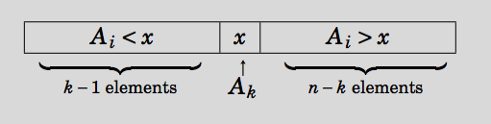

Algorithm – Step 6
Let k be the “rank” of x: for a set of numbers S, x is the $k^{th}$ smallest number in S.

Slide 12
Algorithm – Step 7
a. If i = k, then return x.
b. If i < k, then recurse using median-of-medians on (A[1, ……, k-1], i).
c. If i >k, recurse using the median-of-medians on (A[k+1, ……, i ], i-k)
Case: b
Case: c

Slide 13
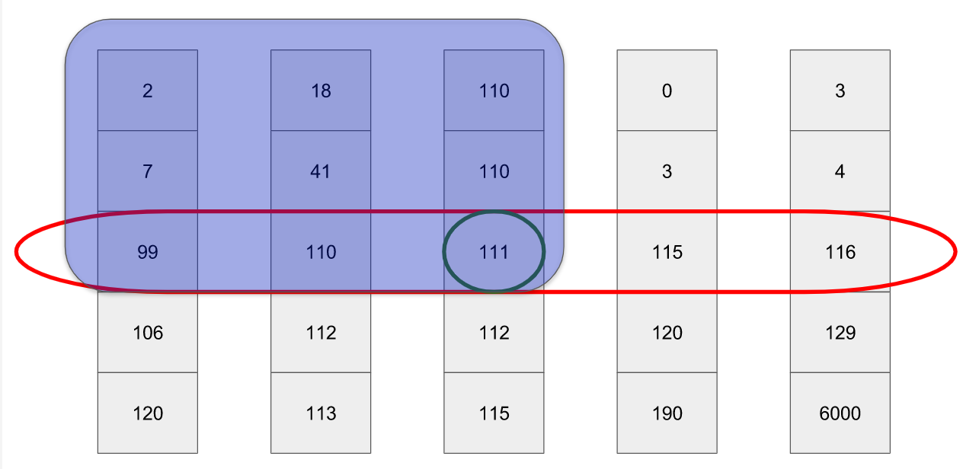
Prove why the median-of-medians is a good pivot
Top left
Top right
Top left: Every item in this quadrant is strictly less than the median
Bottom left: These items may be bigger (or smaller!) than the median
Top right: These items may be bigger (or smaller!) than the median
Bottom right: Every item in this quadrant is strictly greater than the median
Bottom left
Bottom right

Slide 14
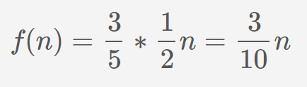
Prove continue
Worst possible case : where our pivot falls as early in the list as possible.
Because the top left is strictly less than our pivot. Therefore, at each step, at minimum, we will remove, at minimum, 30% of the rows. Thus:

Slide 15
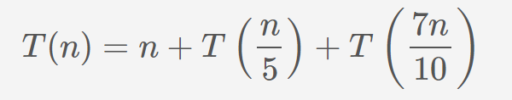
Prove continue
At each step, our algorithm must do:
O(n) work to partition the elements
Solve 1 subproblem 1⁄5 the size of the original to compute the median of medians
Solve 1 subproblem 7⁄10 the size of the original as the recursive step
This yields the following equation for the total runtime, T(n):
By master theorem: T(n) is O(n)

Slide 16
Example
A=[25,21,98,100,76,22,43,60,89,87] , k = 3
1. A1 = [25,21,98,100,76] , A2 = [22,43,60,89,87]
2. Median of A1 = 76 , Median of A2 = 60 -> median list = [76,60]
3. Median of median list = 76
4. Use 76 as pivot A = [25,21,22,43,60,76,98,100,89,87]
5. k < index of pivot (6) , execute median of median on
A_left = [25,21,22,43,60]
6. recusively execute till get the answer

